Slide 1
LICENSE PLATE DETECTION AND CHARACTER RECOGNITION AN APPLICATION OF IMAGE PROCESSING
ROHAN.N.KALPAVRUKSHA PES1201802830
ROSHAN.N.KALPAVRUKSHA PES1201802834
GUIDE NAME - RAGHAVENDRA M J

Slide 2
AIM
TO DISPLAY THE CHARACTERS PRESENT IN LICENSE PLATE FROM A CAR IMAGE
The use of vehicles has increased exponentially day by day and thereby violation of traffic rules, theft of vehicles, entering in restricted areas, high number of accidents lead to increase in the crime rates.
Vehicle license plate detection technique can be significantly used in the field of vehicle security and safety system.
ORIGINAL IMAGE
VEHICLE IMAGE CAPTURE
TARGET IMAGE
NUMBER PLATE DETECTION
OUTPUT TEXT
CHARACTER RECOGNITION

Slide 3
INTRODUCTION
The motto behind the project is detecting the cars number plate automatically and provide them with pay-slip and then open the road for that particular car. Parking authorities also use this system for allowing the vehicle to park in their area. In this system, firstly we capture the image of number plate then process it and read each and every character present in the number plate for their perfect recognition. The most significant phase is OCR, where the letterings on the image of number plate are changed into the texts which can be decoded later
Number Plate Recognition system is a security system. Image processing concept is used in Number Plate Recognition system. OCR (Optical Character Recognition) scheme is also applied in this for reading the image of vehicle number plate.In India, the number plate containing white background with black foreground color is used for private cars and for the commercial vehicles yellow is used as background and black as foreground color.
Every module plays a vital role in gaining efficiency and accuracy. The challenges here are font size and style variations, angle of the picture, low contrast light effect, speed of the vehicles. Machine learning algorithms are fed through unsupervised learning.

Slide 4
LITERATURE SURVEY
Priyanka Prabhakar, Anupama P, Resmi S R, “Automatic Number Plate Detection and Recognition“,International Conference on Control, Instrumentation, Communication and Computational Technologies (ICCICCT), 2014
Preprocessing such as applying sharpness, histogram equalization, smooth the rectangle, Threshold is applied. Methodology used is i/p image ->edge detection->hough transform->hough limit->character segmentation->recognition. The accuracy acquired through this is 98% for shorter distance and 95 % for longer distance. The scope for future is reducing computation overhead introducing parallelism into the design makes it longer economical and time efficient.
Mahesh Babu K, M V Raghunadh, “Vehicle Number Plate Detection and Recognition using Bounding Box Method”, 2016 International Conference on Advanced Communication Control and Computing Technologies (ICACCCT), ISBN No.978-1-4673-9545-8 106
Preprocessing such as frame selection and number plate extraction I = 0.114 *R+0.587*G+0.299*B is used. Methodology used is localization, dilation, segmentation and recognition. The accuracy acquired through this is 93.33%. The scope for future is to deal with blurred images and similar characters.

Slide 5
PROPOSED METHODOLOGY
INPUT ORIGINAL RGB IMAGE
CONVERSION TO GRAYSCALE IMAGE
CANNY EDGE DETECTION
FIND CONTOURS BASED ON EDGES
CREATE ROI AROUND IT
FIND THE CONTOUR WITH 4 POTENTIAL CORNERS
INITIALIZE X,Y COORDINATES
INITIALIZE LICENSE PLATE CONTOUR
REMOVING NOISE FROM TARGET IMAGE
TEXT RECOGNITION
WRITE THE TEXT ON OUTPUT IMAGE

Slide 6
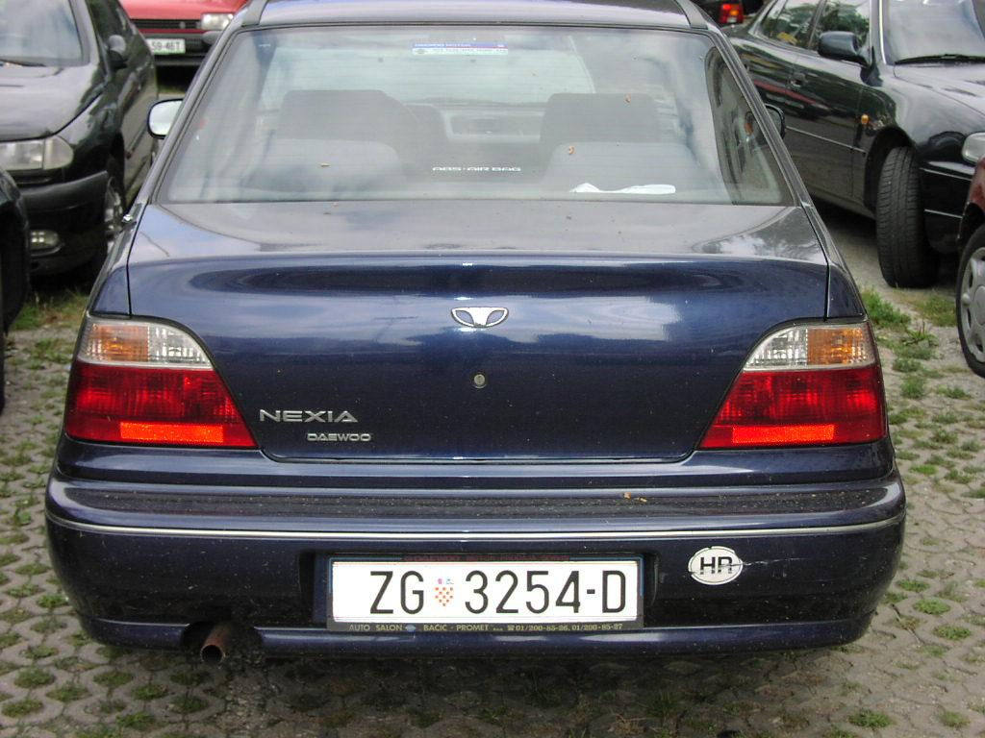
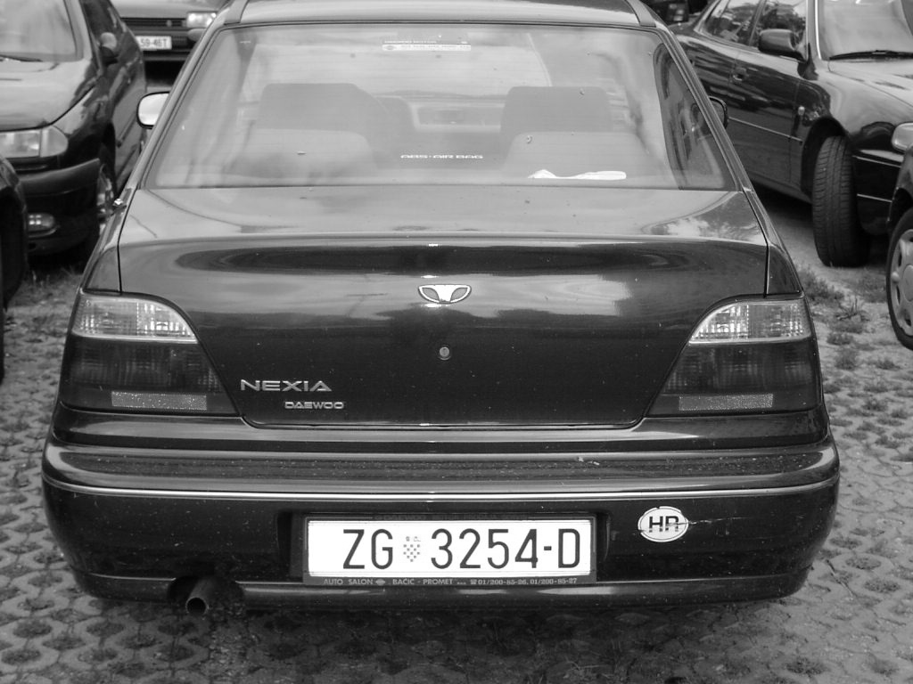
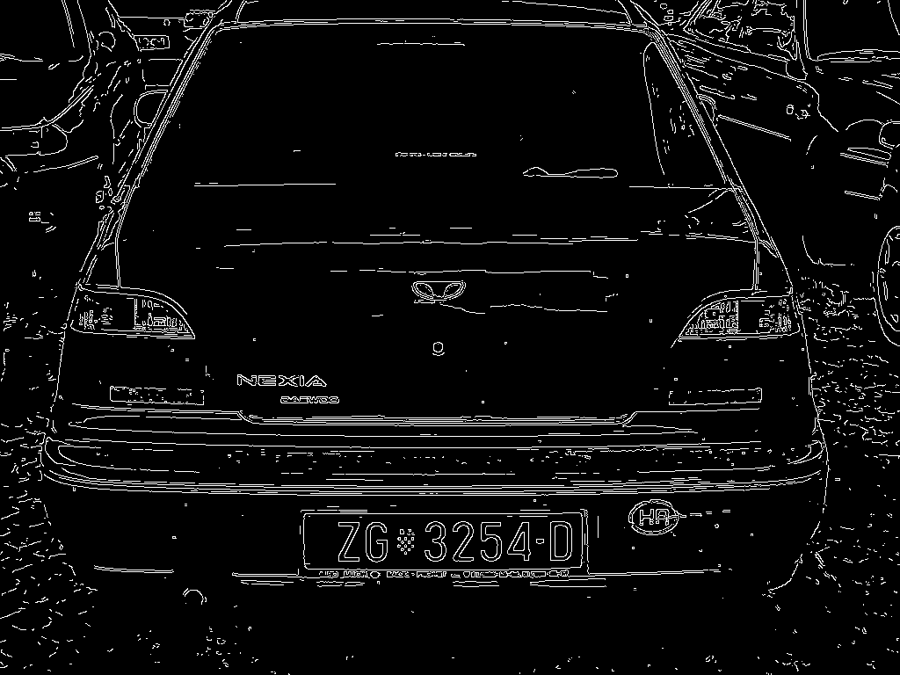
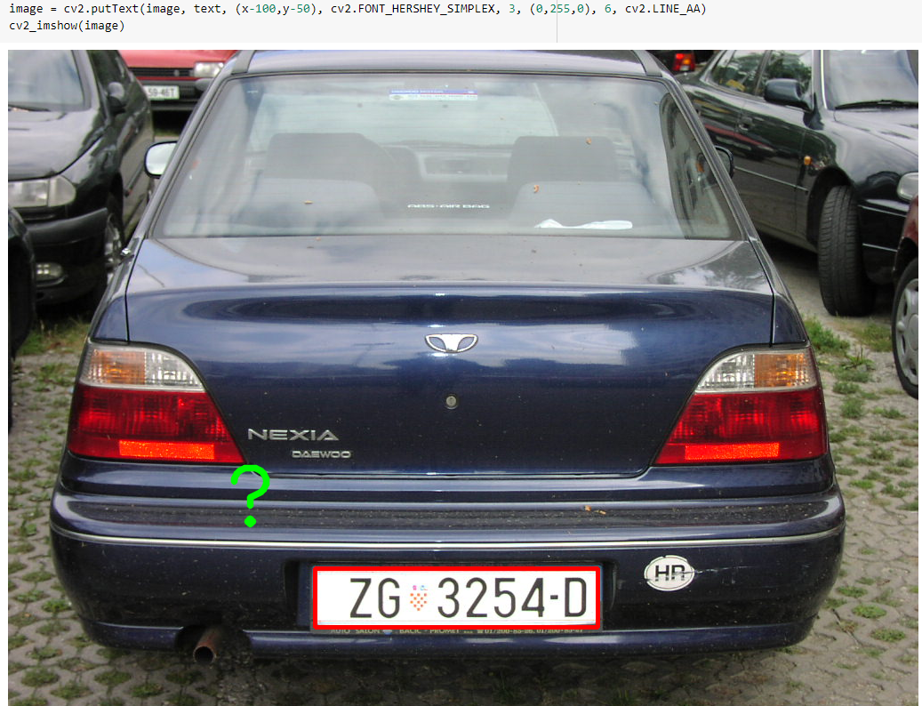
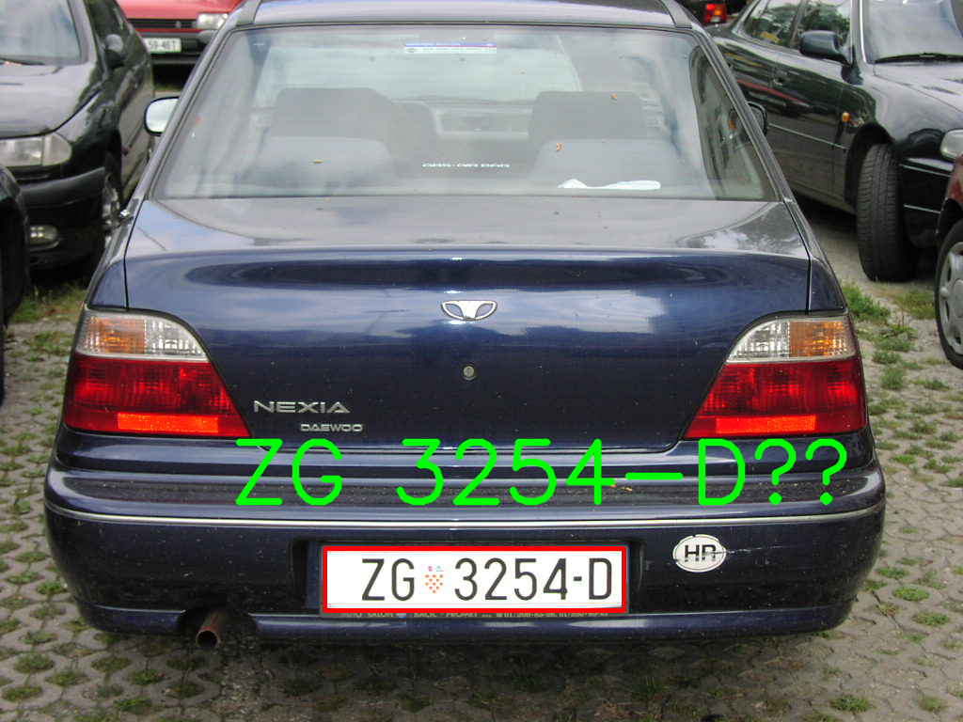



Slide 7


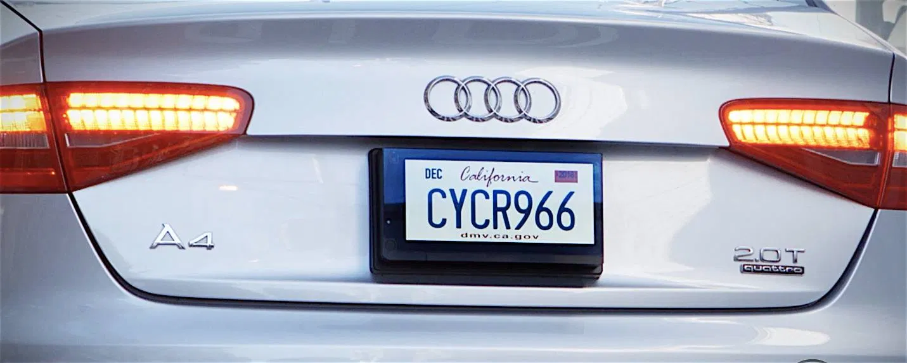


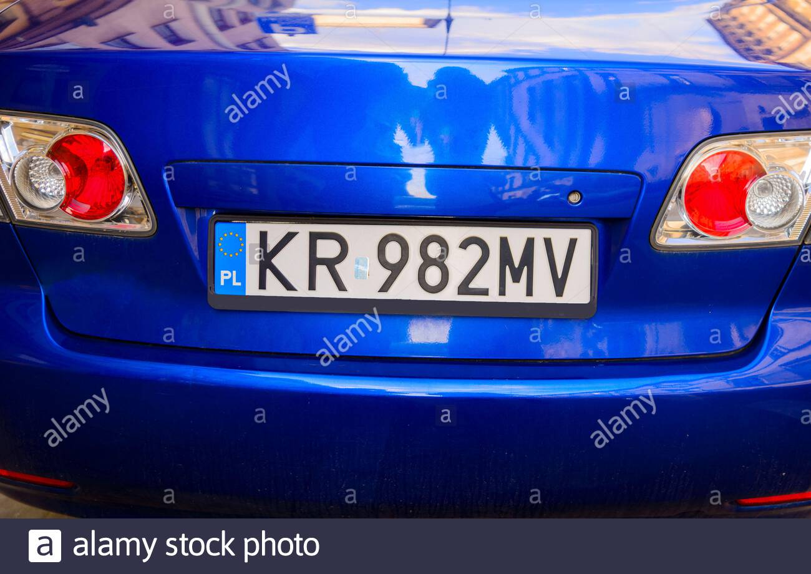

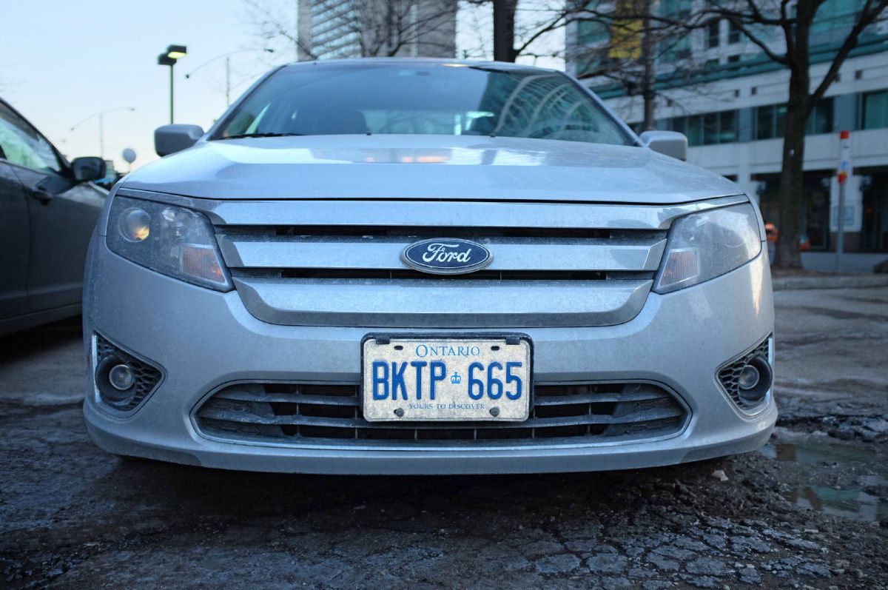

DATASET

Slide 8
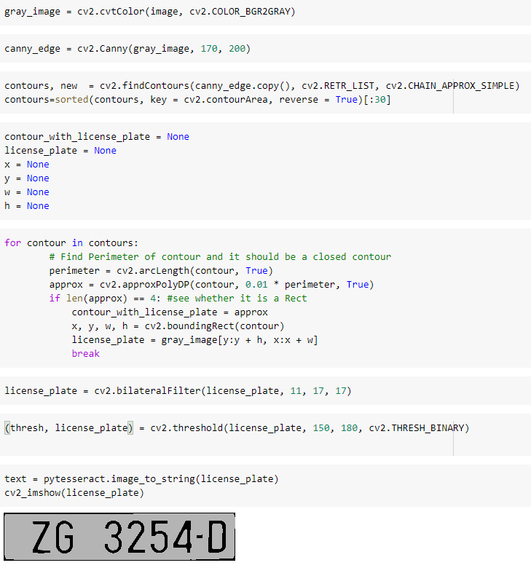
RESULT
We are done with the working on the following
Recognition of characters from a image
Recognition of the target from the given image
Implemented detecting characters from blurred or defocused image

Slide 9
CONCLUSION
This project can be further exploited for vehicle owner identification, vehicle model identification traffic control, vehicle speed control and vehicle location tracking. It can be further extended as multilingual character recognition to identify the language of characters automatically based on the training data.
It can provide various benefits like traffic safety enforcement, security- in case of suspicious activity by vehicle, easy to use, immediate information availability- as compare to searching vehicle owner registration details manually and cost effective for any country. For low resolution images some improvement algorithms like super resolution of images should be focused. Most of our project focus on processing one vehicle number plate but in real-time there can be more than one vehicle number plates while the images are being captured.
Obviously, the accuracy of the recognition is the most important in this system. Therefore, this application should be optimized and modified for overcoming the accuracy limitations. In order to make the recognition more precise, we should add some preprocesses to remove the interferences. Moreover, we would continue the further study for license plate recognition in some complicated environments, such as vehicles at dark night or in heavy rains and so on. If we could accomplish all of the objectives, this application would have a very promising future.

Slide 10
REFERENCES
Priyanka Prabhakar, Anupama P, Resmi S R, “Automatic Number Plate Detection and Recognition“,International Conference on Control, Instrumentation, Communication and Computational Technologies (ICCICCT), 2014
Mahesh Babu K, M V Raghunadh, “Vehicle Number Plate Detection and Recognition using Bounding Box Method”, 2016 International Conference on Advanced Communication Control and Computing Technologies (ICACCCT), ISBN No.978-1-4673-9545-8 106
Abhishek Kashyap, B. Suresh, Anukul Patil, Saksham Sharma, Ankit Jaiswal, “Automatic Number Plate Recognition“, International Conference on Advances in Computing, Communication Control and Networking (ICACCCN2018), ISBN: 978-1-5386-4119-4/18/$31.00 ©2018 IEEE
Deniing Jiang, Tulu Muluneh Mekonnen, Tiruneth Embiale,AshenafiGebrehiwot “Car Plate Recognition System” in Fifth internation conference on Intelligent Networks and Intelligent Systems, IEEE, 978-0-7695-4855-5/12 2012.
Rahim Panahi, Iman Gholampour, "Accurate Detection and Recognition of Dirty Vehicle Plate Numbers for High Speed Applications",. IEEE Transactions on Intelligent Transportation Systems, 2017
https://www.ijert.org/a-review-paper-on-vehicle-number-plate-recognition
https://www.imedpub.com/articles/a-review-paper-on-license-plate-recognition
https://ieeexplore.ieee.org/document/8748287

